Slide 1

District 7690
2023-2024 District Grants
Training
September 24, 2022

Slide 2

Memorandum of Understanding (MOU)
Complete the MOU (memorandum of understanding) and have it signed by the president and president elect for the year to which it applies between February 19 and April 30.

Slide 3
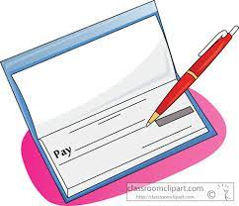
Separate Checking Account
Set up a separate grants checking account if not already done, and follow other financial requirements set forth in the MOU.

Slide 4
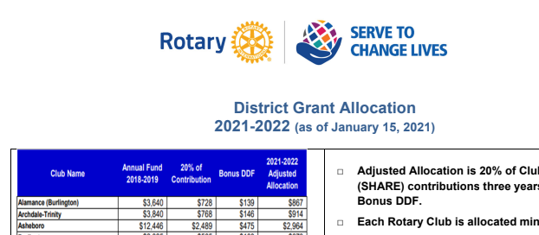
Club Allocation of DDF
Be sure the DDF (district designated funds) you request for your grant(s) do not exceed the total DDF allocated to your club.

Slide 5
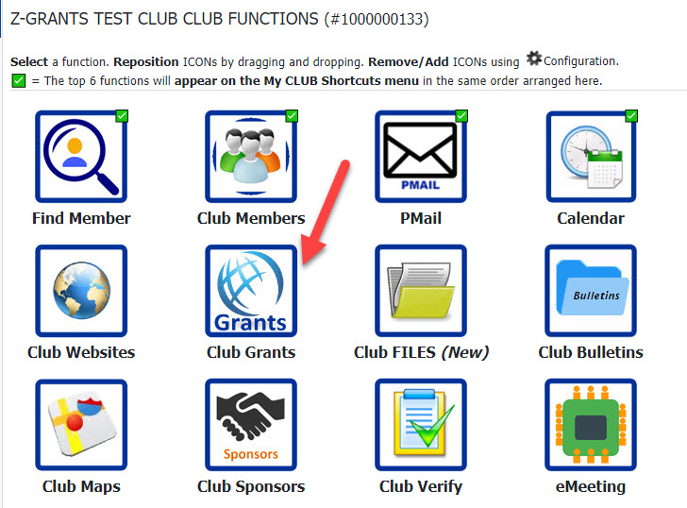
DG Application
To access district grants from your MY CLUB tab, click on the GRANTS icon.

Slide 6
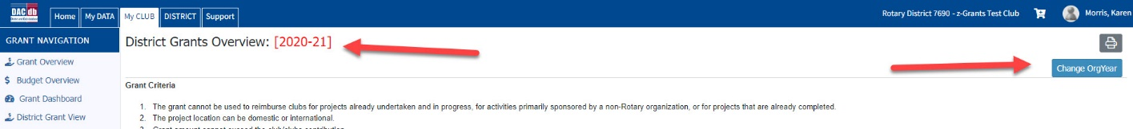
Choose 2023-2024
Be sure you’re in the correct ORG YEAR for the grant you’re requesting.

Slide 7
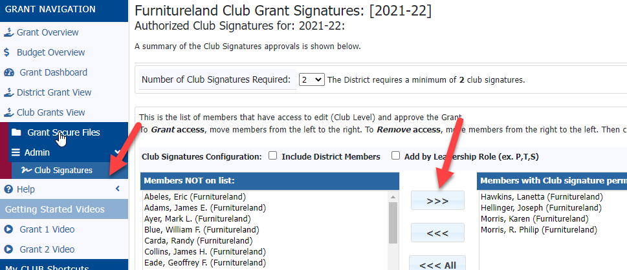
Two Club Signers
Set up two club signers for your club.

Slide 8
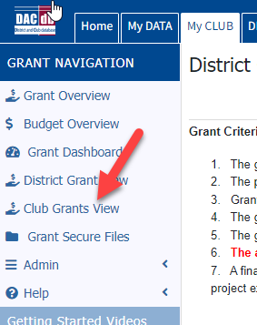
Find Club Grants
Go to CLUB GRANTS VIEW under Grant Navigation

Slide 9
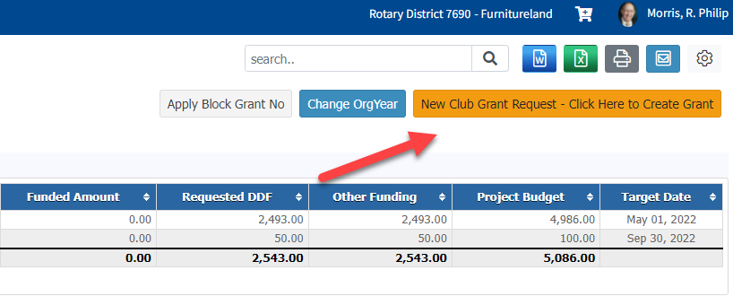
New Club Grant Request
Click NEW CLUB GRANTS REQUEST

Slide 10
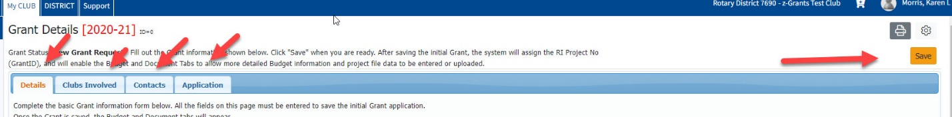
Complete the Application
Fill out the requested information in the four tabs that appear, and press save.

Slide 11
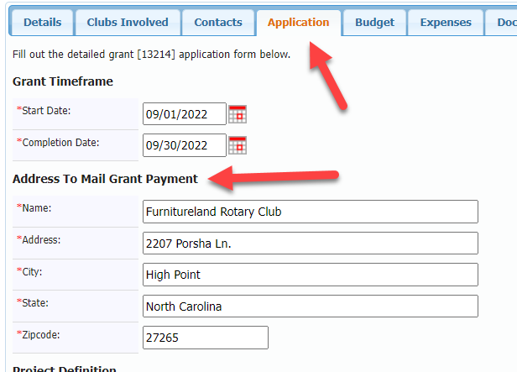
Address for Grant Check
In the APPLICATION tab, fill out the address to which you’d like the grant check to be sent, which may be different than your club’s main checking address, so that it will go to the person in charge of grant finances.

Slide 12
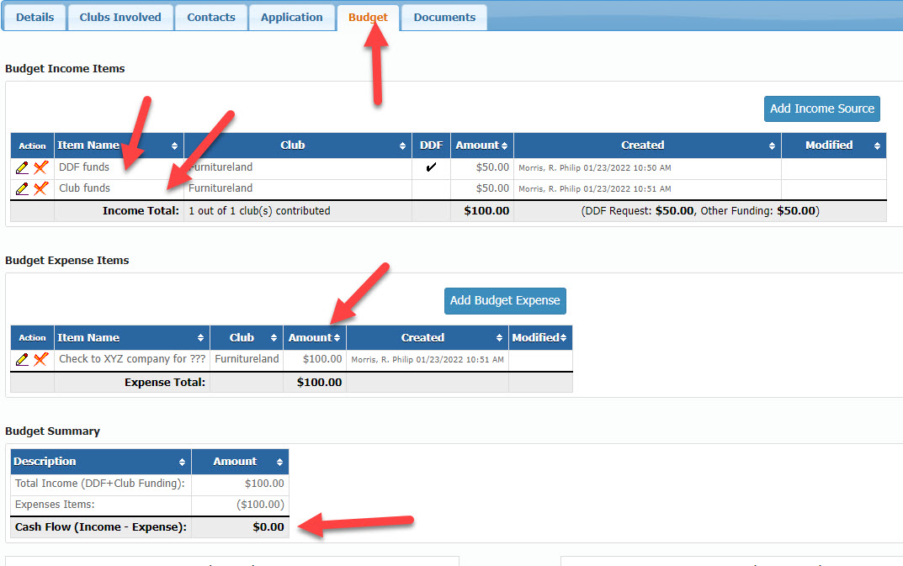
Budget
Two more tabs will appear. The most important is the BUDGET tab.

Slide 13
Budget

Slide 14
Income
For each club participating, DDF funds requested must be matched or exceeded by club funds contributed.

Slide 15
Expenses
Estimate the expenses that will apply to the grant.

Slide 16
Income and Expenses
Income and expenses must match.

Slide 17
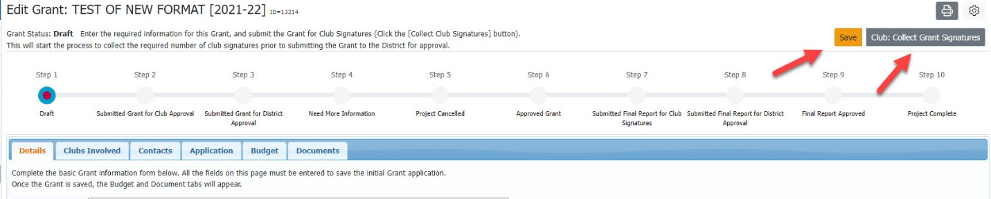
Save Application
When your grant is complete, press SAVE, and CLUB collect grant signatures. Club signers will receive an email telling them the grant is ready to be signed.

Slide 18
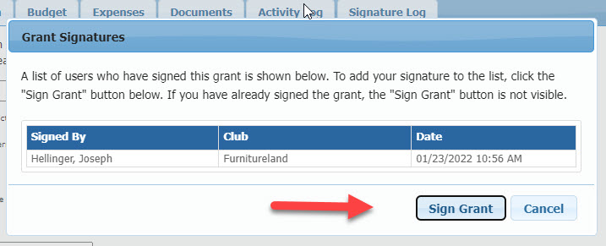
Club Signatures
Club signers will press a button on the upper right that says CLUB SIGN GRANT. A pop-up box will appear. The signer presses the SIGN GRANT button.

Slide 19
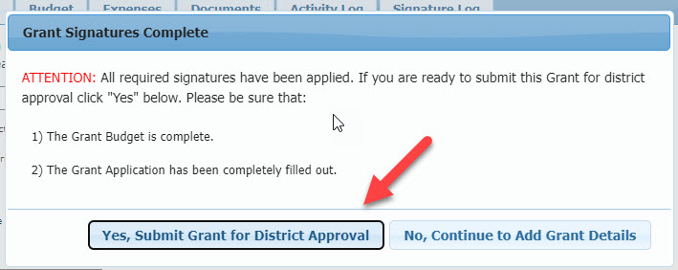
Submit
When the required signatures have been collected from each club, the last person signing the grant presses the button to submit the grant for district approval. This year we will allow the lead club to be the only signer in a multi-club grant.

Slide 20
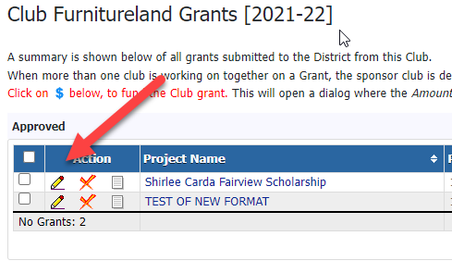
View Your Grant
Once a grant has been created, access the grant by clicking on the pencil, NOT the name of the grant itself.

Slide 21
Creating the Final Report
Be sure all signers originally set up are still available or add new signers if needed.

Slide 22
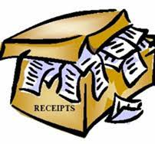
Gather all receipts relevant to the grant.
Be sure they’re legible and face in the same direction.
Avoid including items not applicable to the grant, as when a person is reimbursed for several purchases, some which apply to the grant and some which do not.

Slide 23

Collect proof of payment of the receipts that apply to the grant.
These can be
Cancelled checks
Bank statements
Acknowledgement letters from recipients of the funds

Slide 24
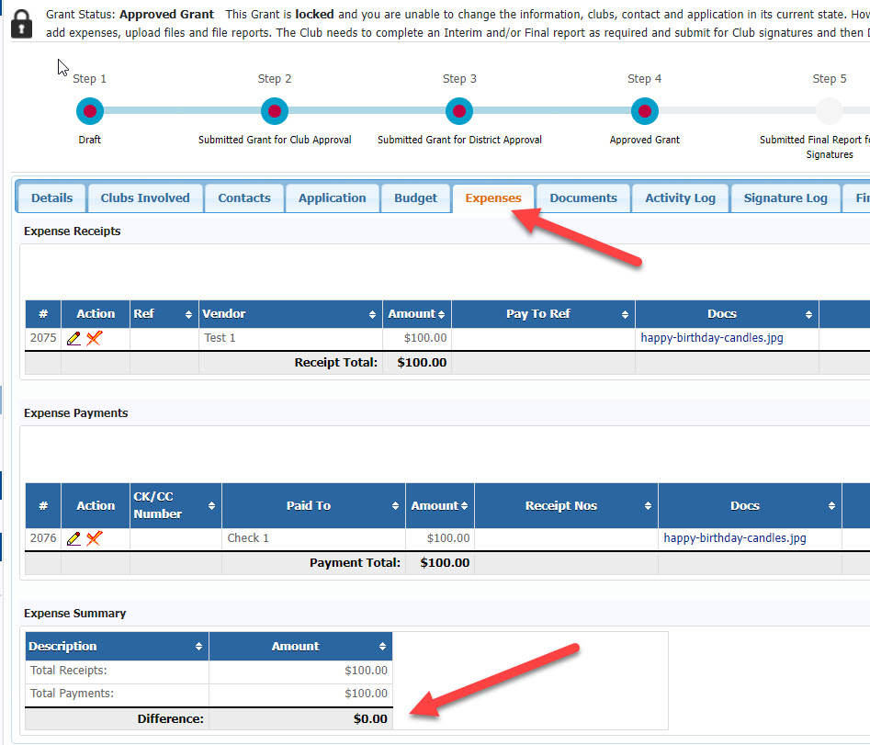
Fill out the EXPENSES tab

Slide 25
Expenses

Slide 26
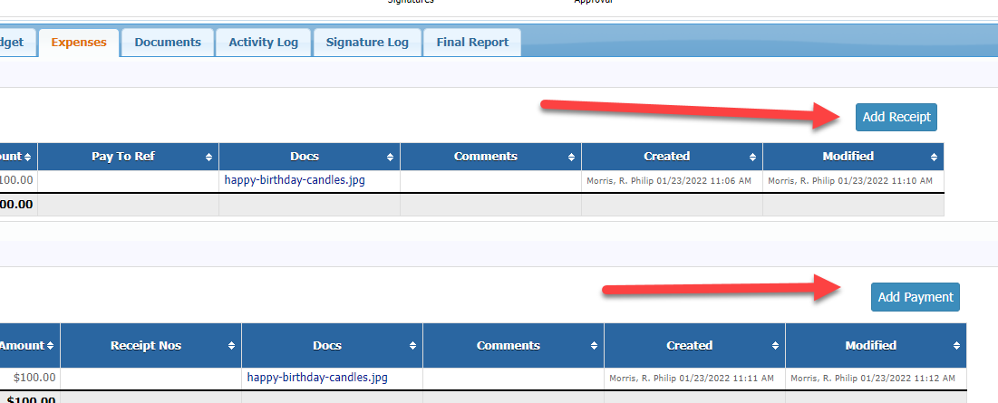
Receipts and Payments
Click ADD button to add individual receipts and payments.

Slide 27
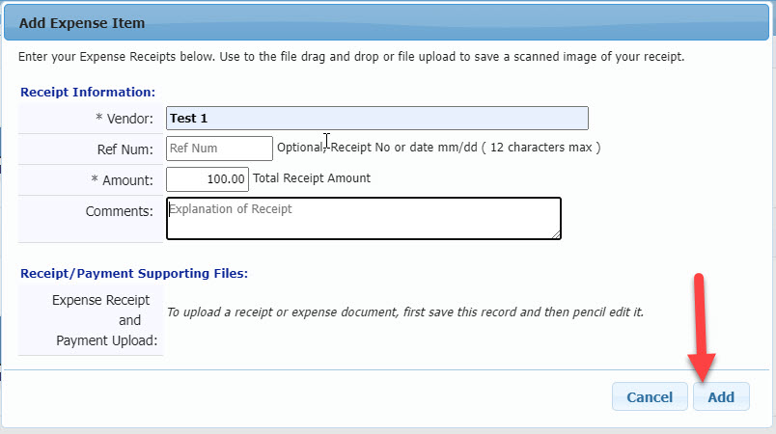
Receipts and Payments
A pop up will appear, in which you’ll enter your receipt or payment. Press ADD to enter the corresponding receipt or proof of payment.

Slide 28
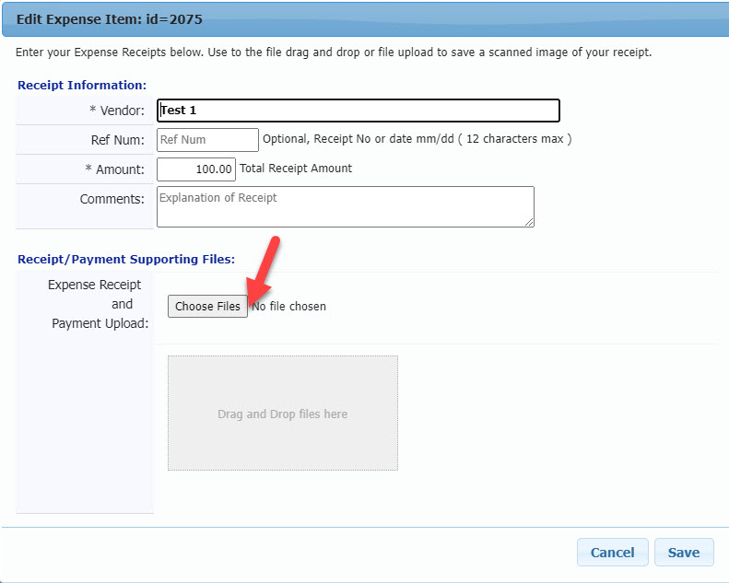
Upload Receipts
A link will appear which will enable you to choose the relevant file from your computer to back up the expense or payment you’ve entered and upload it to the program.

Slide 29
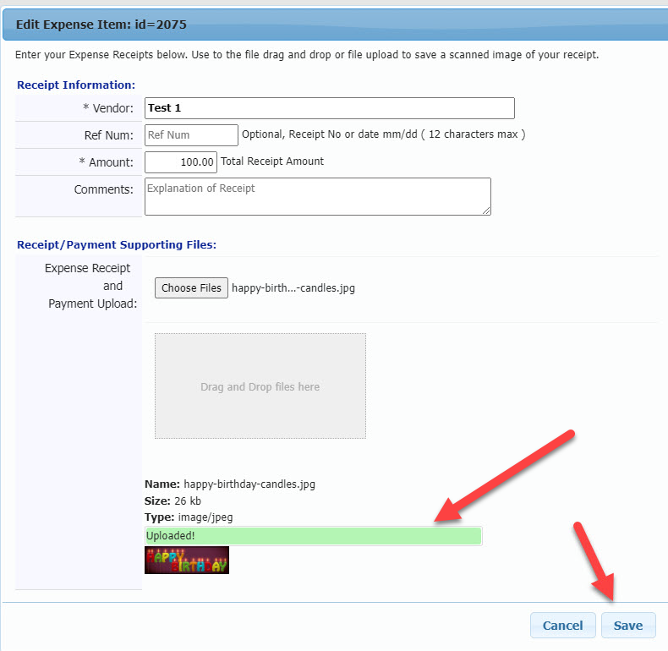
Confirmation
You will get confirmation that the file has been uploaded. Press SAVE.

Slide 30
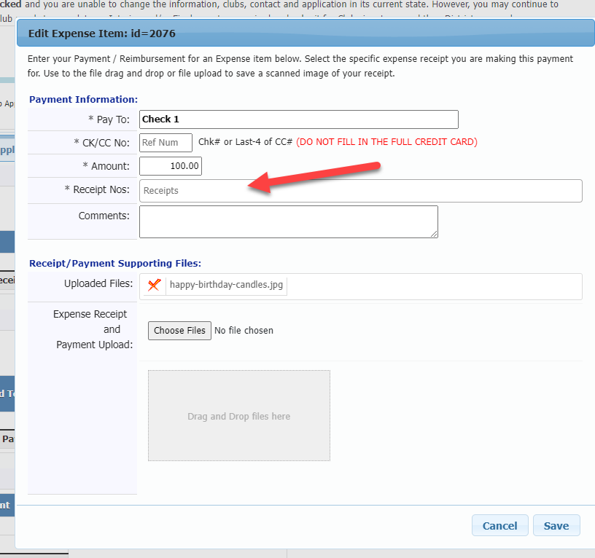
Match Payments and Receipts
Note that when you upload proofs of payment, you can match the payment you’re uploading to the receipts that you uploaded to which they refer.

Slide 31
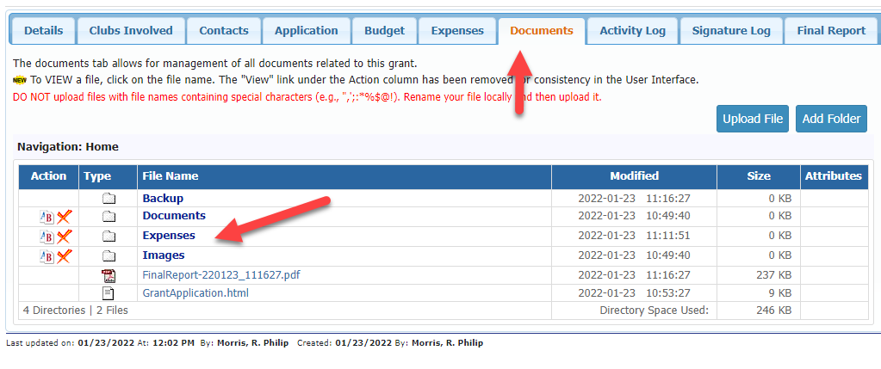
Documents
The documents you have uploaded can be found in the Expenses folder under the DOCUMENTS tab.

Slide 32
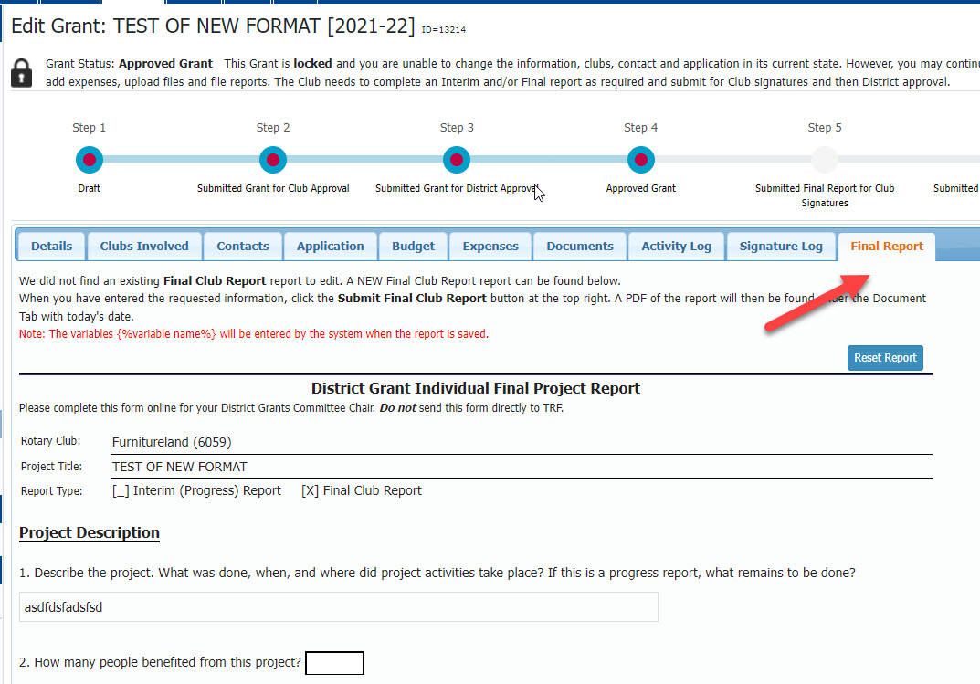
Final Report
Fill out questions asked in the FINAL REPORT tab and press SAVE button.

Slide 33
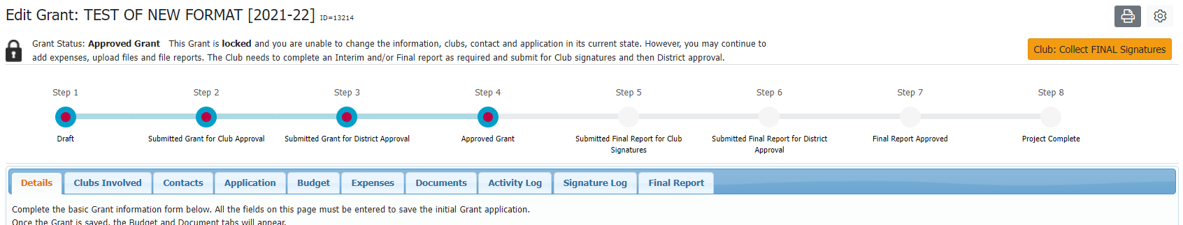
Club Signatures
Press the CLUB COLLECT FINAL SIGNATURES button. Signing the final report will work the same way as signing the original application.

Slide 34
Return Unused DDF Funds
If you have not used all the funds requested for the grant, the unused portion of the DDF funds must be returned to the district before the Final Report can be approved.
Example:
Original grant:
DDF $50
Club funds $50
TOTAL $100
Actual expenses for the grant were $90.
DDF $45
Club funds $45
Total $90
The $5 DDF which were not spent need to be returned to the district.

Slide 35
Important Dates:
April 30—all MOUs to district
May 15—last day to submit final reports for 2022-23 grants
May 31—last day to submit application for 2023-24 grants
May 15, 2023– last day for district to accept 2022-23 final reports. Final reports should be submitted within a month of the completion of the project.

